Slide 1
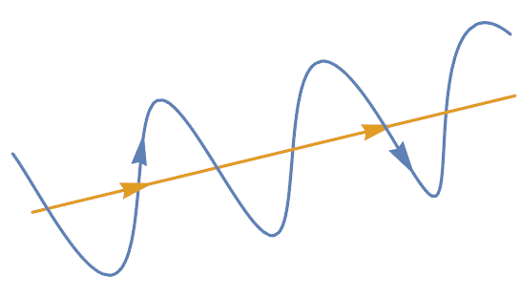
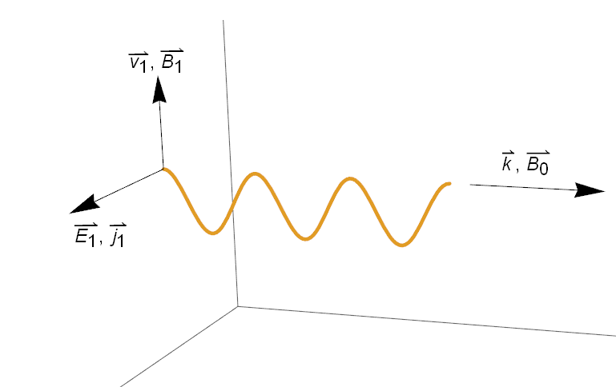
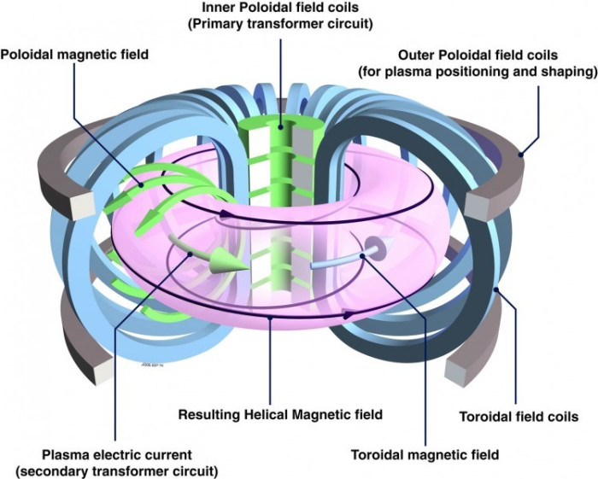
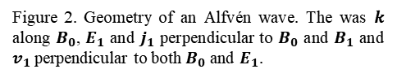
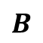
$$B$$
Figure 1. Graphical representation of the path of a charged particle (blue) travelling along a magnetic field line (yellow).
Figure 2. Geometry of an Alfvén wave. The was $k$ along $B_{0}$, $E_{1}$ and $j_{1}$ perpendicular to $B_{0}$ and $B_{1}$ and $v_{1}$ perpendicular to both $B_{0}$ and $E_{1}$.
Not Used. Cartoon of a tokamak device with plasma shown in purple. The blue toroidal field coils produce a strong magnetic field in the toroidal direction. Similarly, the green and grey poloidal field coils create a magnetic field in the poloidal field. The toroidal and poloidal fields combine to form a closed helical magnetic field in the toroidal direction.

Slide 2
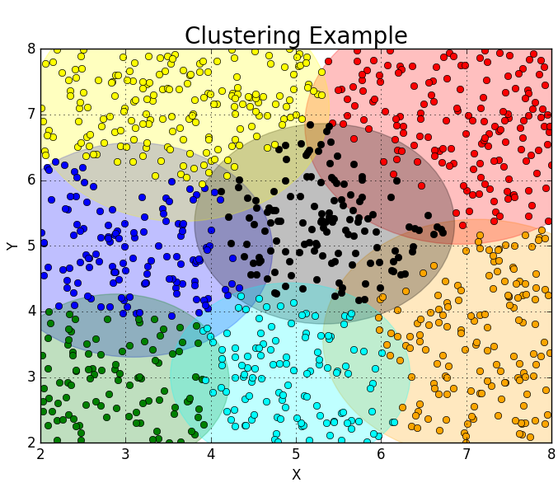
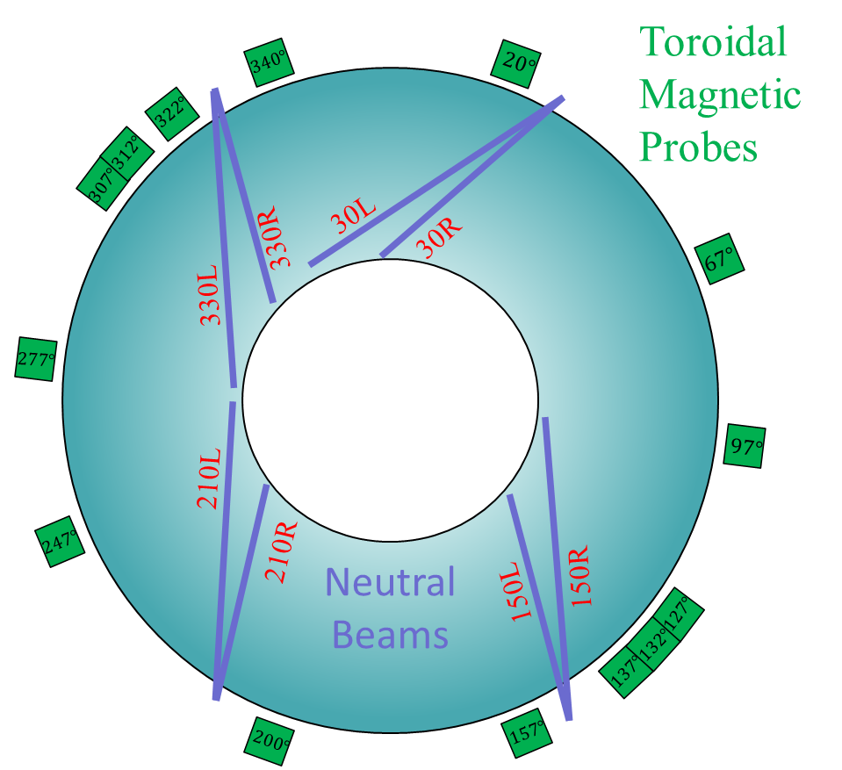
Figure 3. Cartoon of top down view of DIII-D. The 4-pairs of neutral beam injectors are shown in purple and the various toroidal magnetic Mirnov probes are shown in green with their angular position indicated.
Figure 5. Sample output from ClusteringExample.py using 1000 random data points and a k-means algorithm with 7 total clusters.

Slide 3
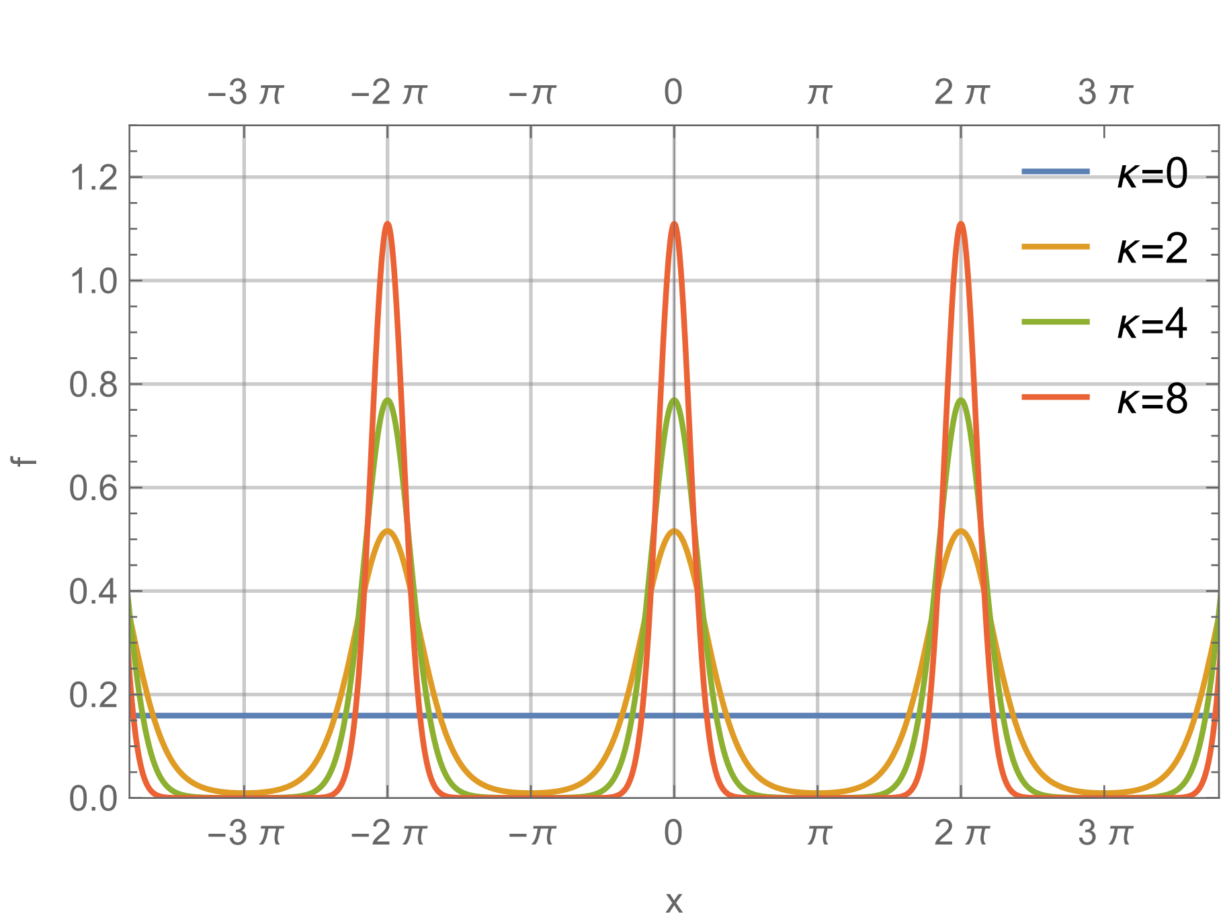
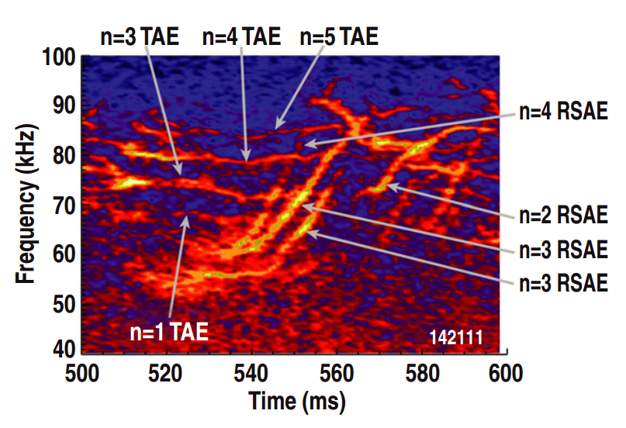
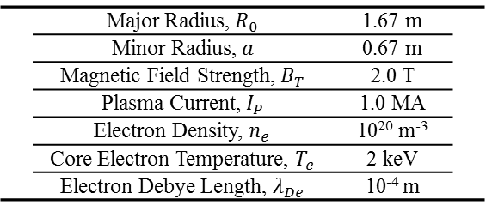
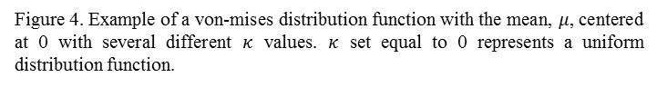
 | Major Radius, $R_{0}$ | 1.67 m
 | Minor Radius, $a$ | 0.67 m
 | Magnetic Field Strength, $B_{T}$ | 2.0 T
 | Plasma Current, $I_{P}$ | 1.0 MA
 | Electron Density, $n_{e}$ | 10²⁰ m⁻³
 | Core Electron Temperature, $T_{e}$ | 2 keV
 | Electron Debye Length, $λ_{De}$ | 10⁻⁴ m
Table 1. Typical plasma parameters at DIII-D.
Figure 4. Example of a von-mises distribution function with the mean, $μ$, centered at 0 with several different $κ$ values. $κ$ set equal to 0 represents a uniform distribution function.
Figure 5. Frequency vs. Time spectrogram for shot 142111 with different Alfvén eigenmodes identified. Figure taken from.
 | Shot | Time Window (ms)
F | 153071 | 2800 – 3000 | F
F | 153072 | 2800 – 3000 | F
F | 152932 | 2500 – 2700 | F
F | 152938 | 3000 – 3200 | F
F | 157399 | 2300 – 2500 | F
F | 157400 | 2300 – 2500 | F
F | 157401 | 2300 – 2500 | F
F | 157402 | 2300 – 2500 | F
Table 2. Shot list and time windows used for the verification process. Each shot has a 200 ms time window which we are interested in.

Slide 4
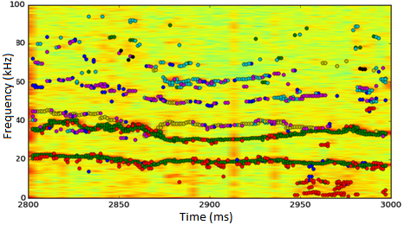
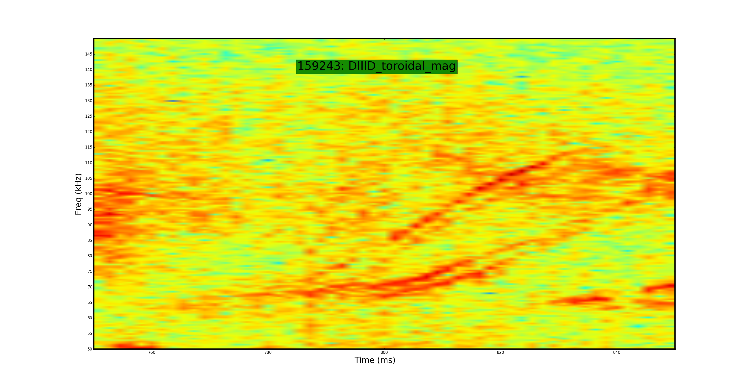
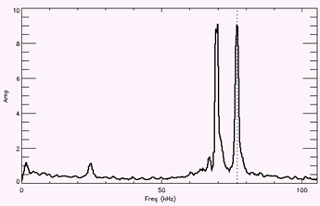
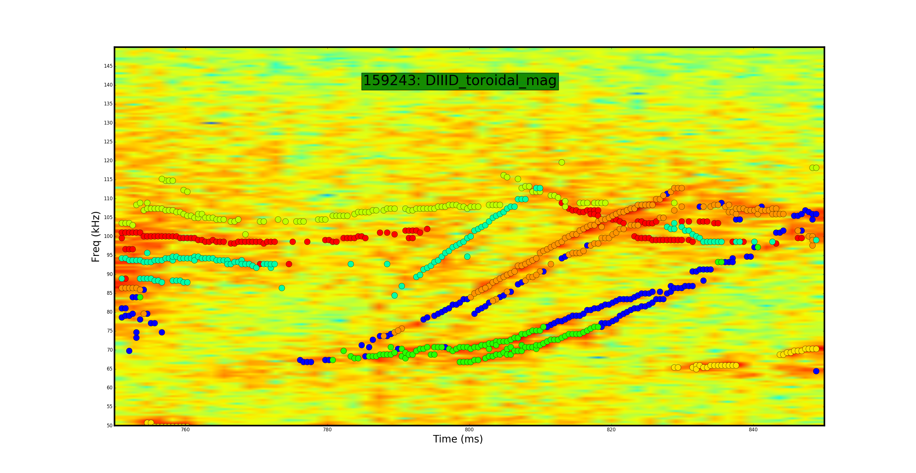
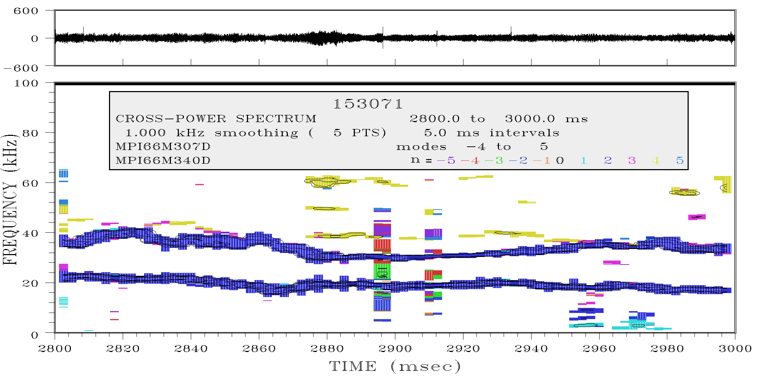
n=5 TAE
n=6 TAE
n=4 RSAE
n=2 RSAE
n=5 TAE
n=6 TAE
70 77
Figure X. Fourier transform of shot 159243 at t = 450 ms. Frequency peaks are shown in red.
n=4 RSAE
n=2 RSAE
Figure . Raw spectrogram. Bottom: Spectrogram with different clusters plotted in different colors. Identification of different Alfvén eigenmodes from Critical gradient behavior of fast-ion transport from AE’s.
Figure X. Comparison with our clustering algorithm (top) with a different mode identifying algorithm (bottom). Top: Different clusters plotted in different colors. Bottom: Different toroidal mode numbers plotted in different colors.

Slide 5
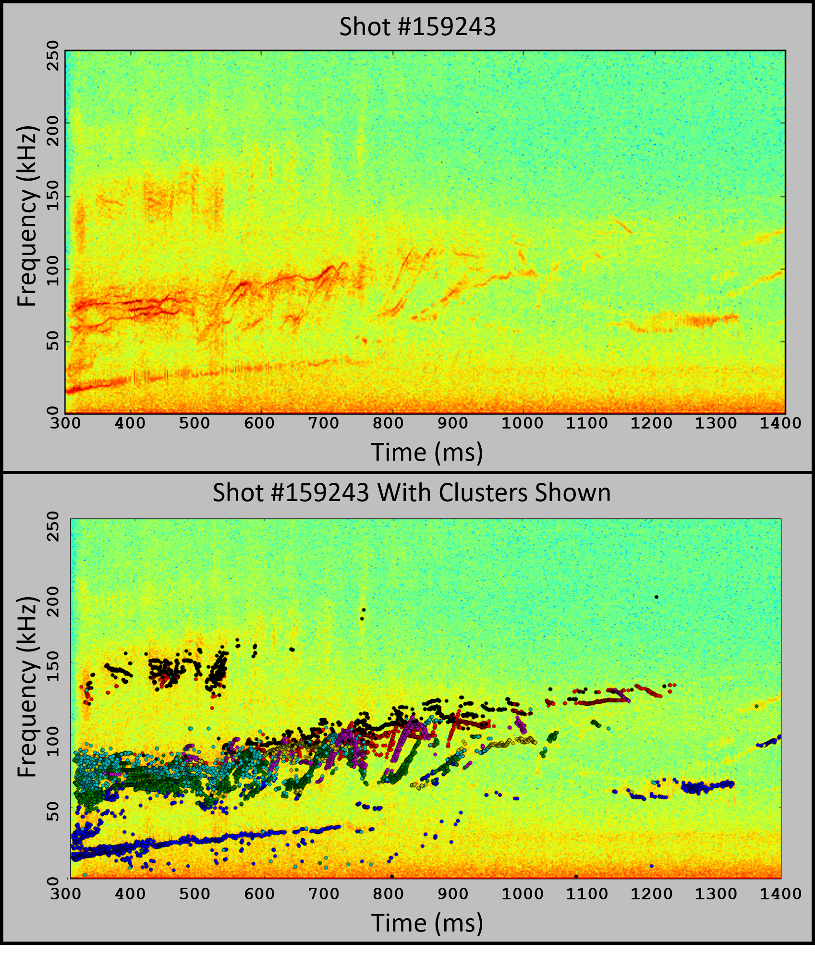
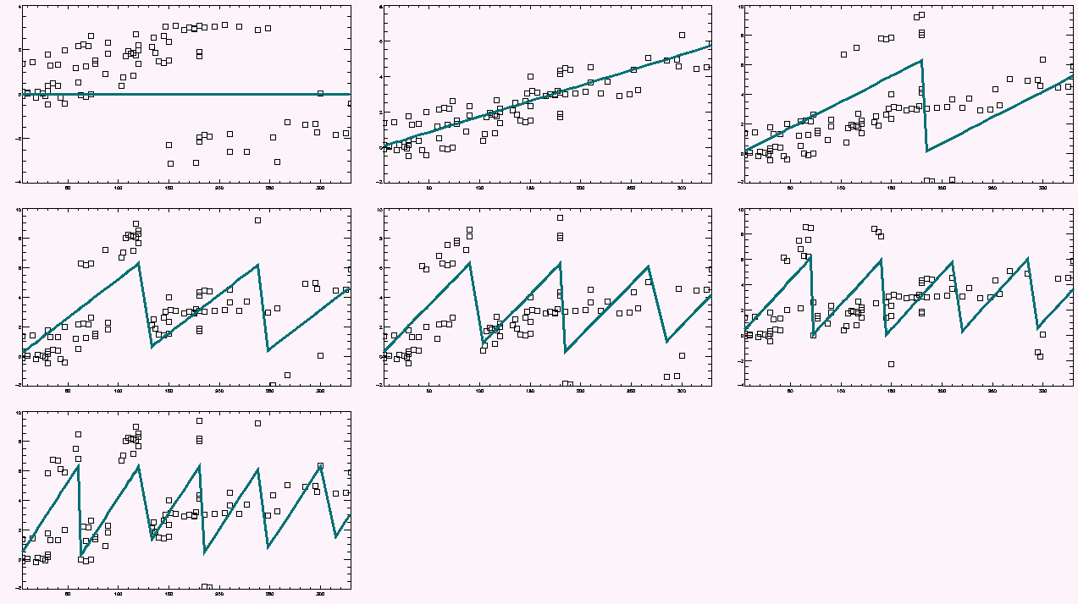
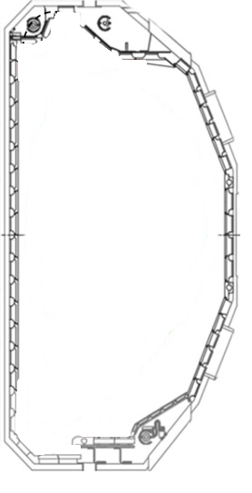
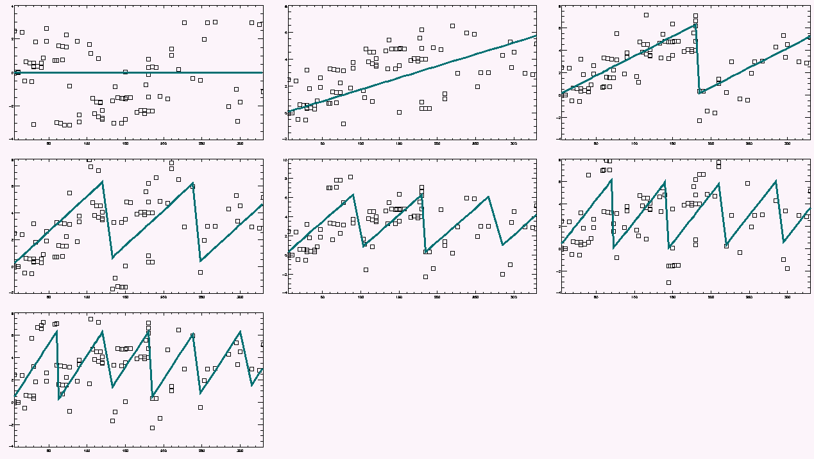
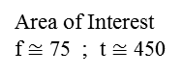
n=1
n=2
n=0
Area of Interest
f $≅$ 75 ; t $≅$ 450
n=4
n=5
n=3
Phase Difference
t = 450 ms
f = 70 kHz
Best fit is
n=1
n=6
Toroidal Angle
Figure X. Spectrogram of shot 159243.
Figure 7. Each graph is an attempt to fit the toroidal mode number. Data points are phases and phase differences between probe pairs. Solid line represents the theoretical fit to that toroidal mode number.
n=0
n=1
n=2
Phase Difference
n=3
n=4
n=5
t = 450 ms
f = 77 kHz
Best fit is
n=2
n=6
Toroidal Angle
Figure X. Poloidal cross section of DIII-D. Probes located outside of the perimeter will have varying distances to the plasma.
Figure 7. Each graph is an attempt to fit the toroidal mode number. Data points are phases and phase differences between probe pairs. Solid line represents the theoretical fit to that toroidal mode number.

Slide 6
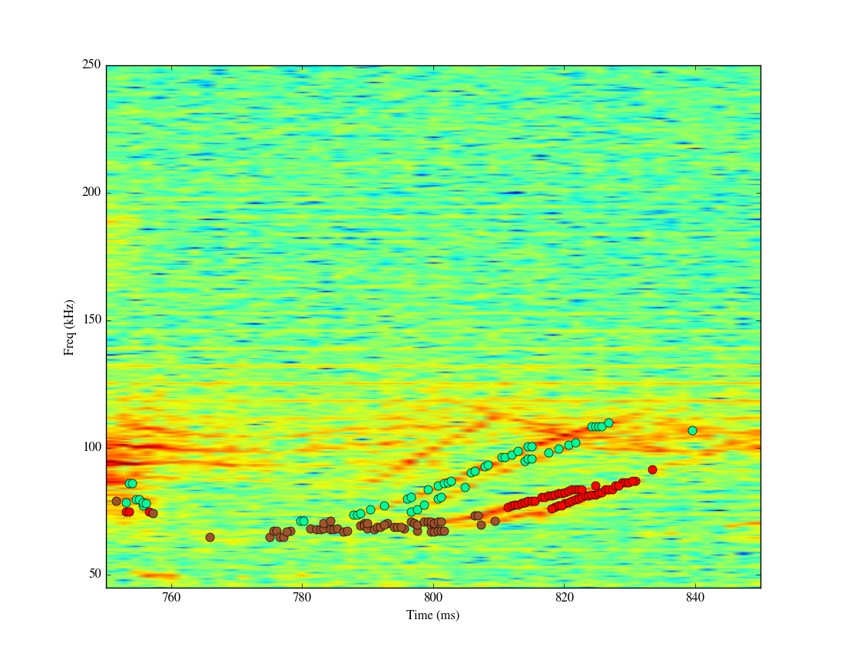
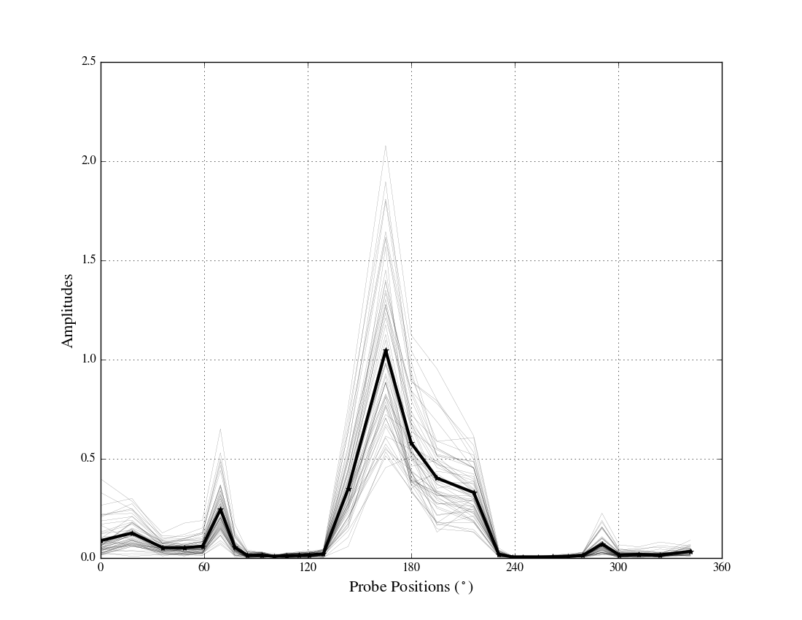
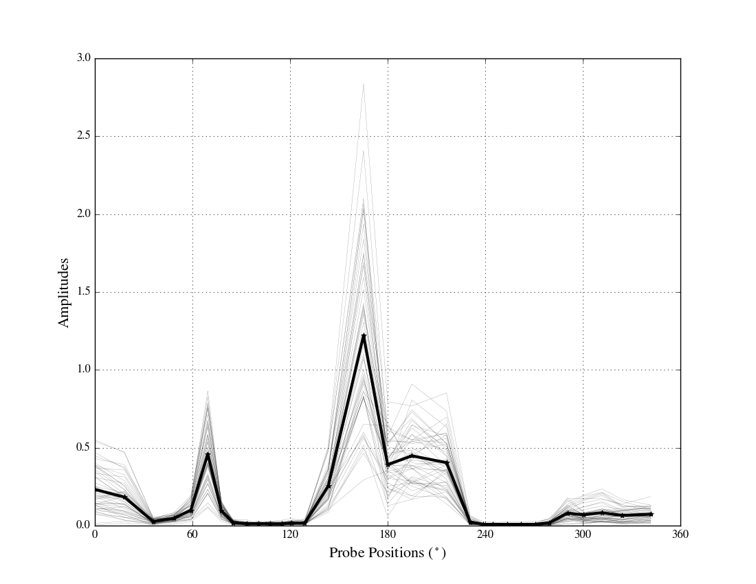
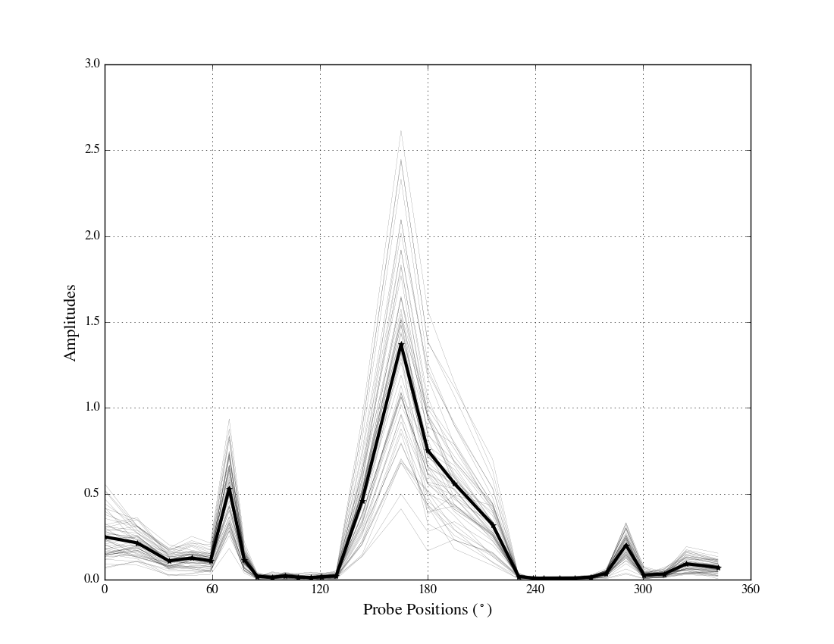
Cluster 1
Cluster 2
Cluster 3
Shot 159243
Figure X. Amplitude vs. probe position for cluster 1. Feint lines correspond to individual signals and the dark line corresponds to the average.
Figure X. Amplitude vs. probe position for cluster 2. Feint lines correspond to individual signals and the dark line corresponds to the average.
Figure X. Amplitude vs. probe position for cluster 1. Feint lines correspond to individual signals and the dark line corresponds to the average.
Figure X. Spectrogram of shot 159243 with 3 different clusters shown. In the following figures, the brown points will be referred to as cluster 1, the red points will be referred to as cluster 2, and the light green points will be referred to as cluster 3.

Slide 7
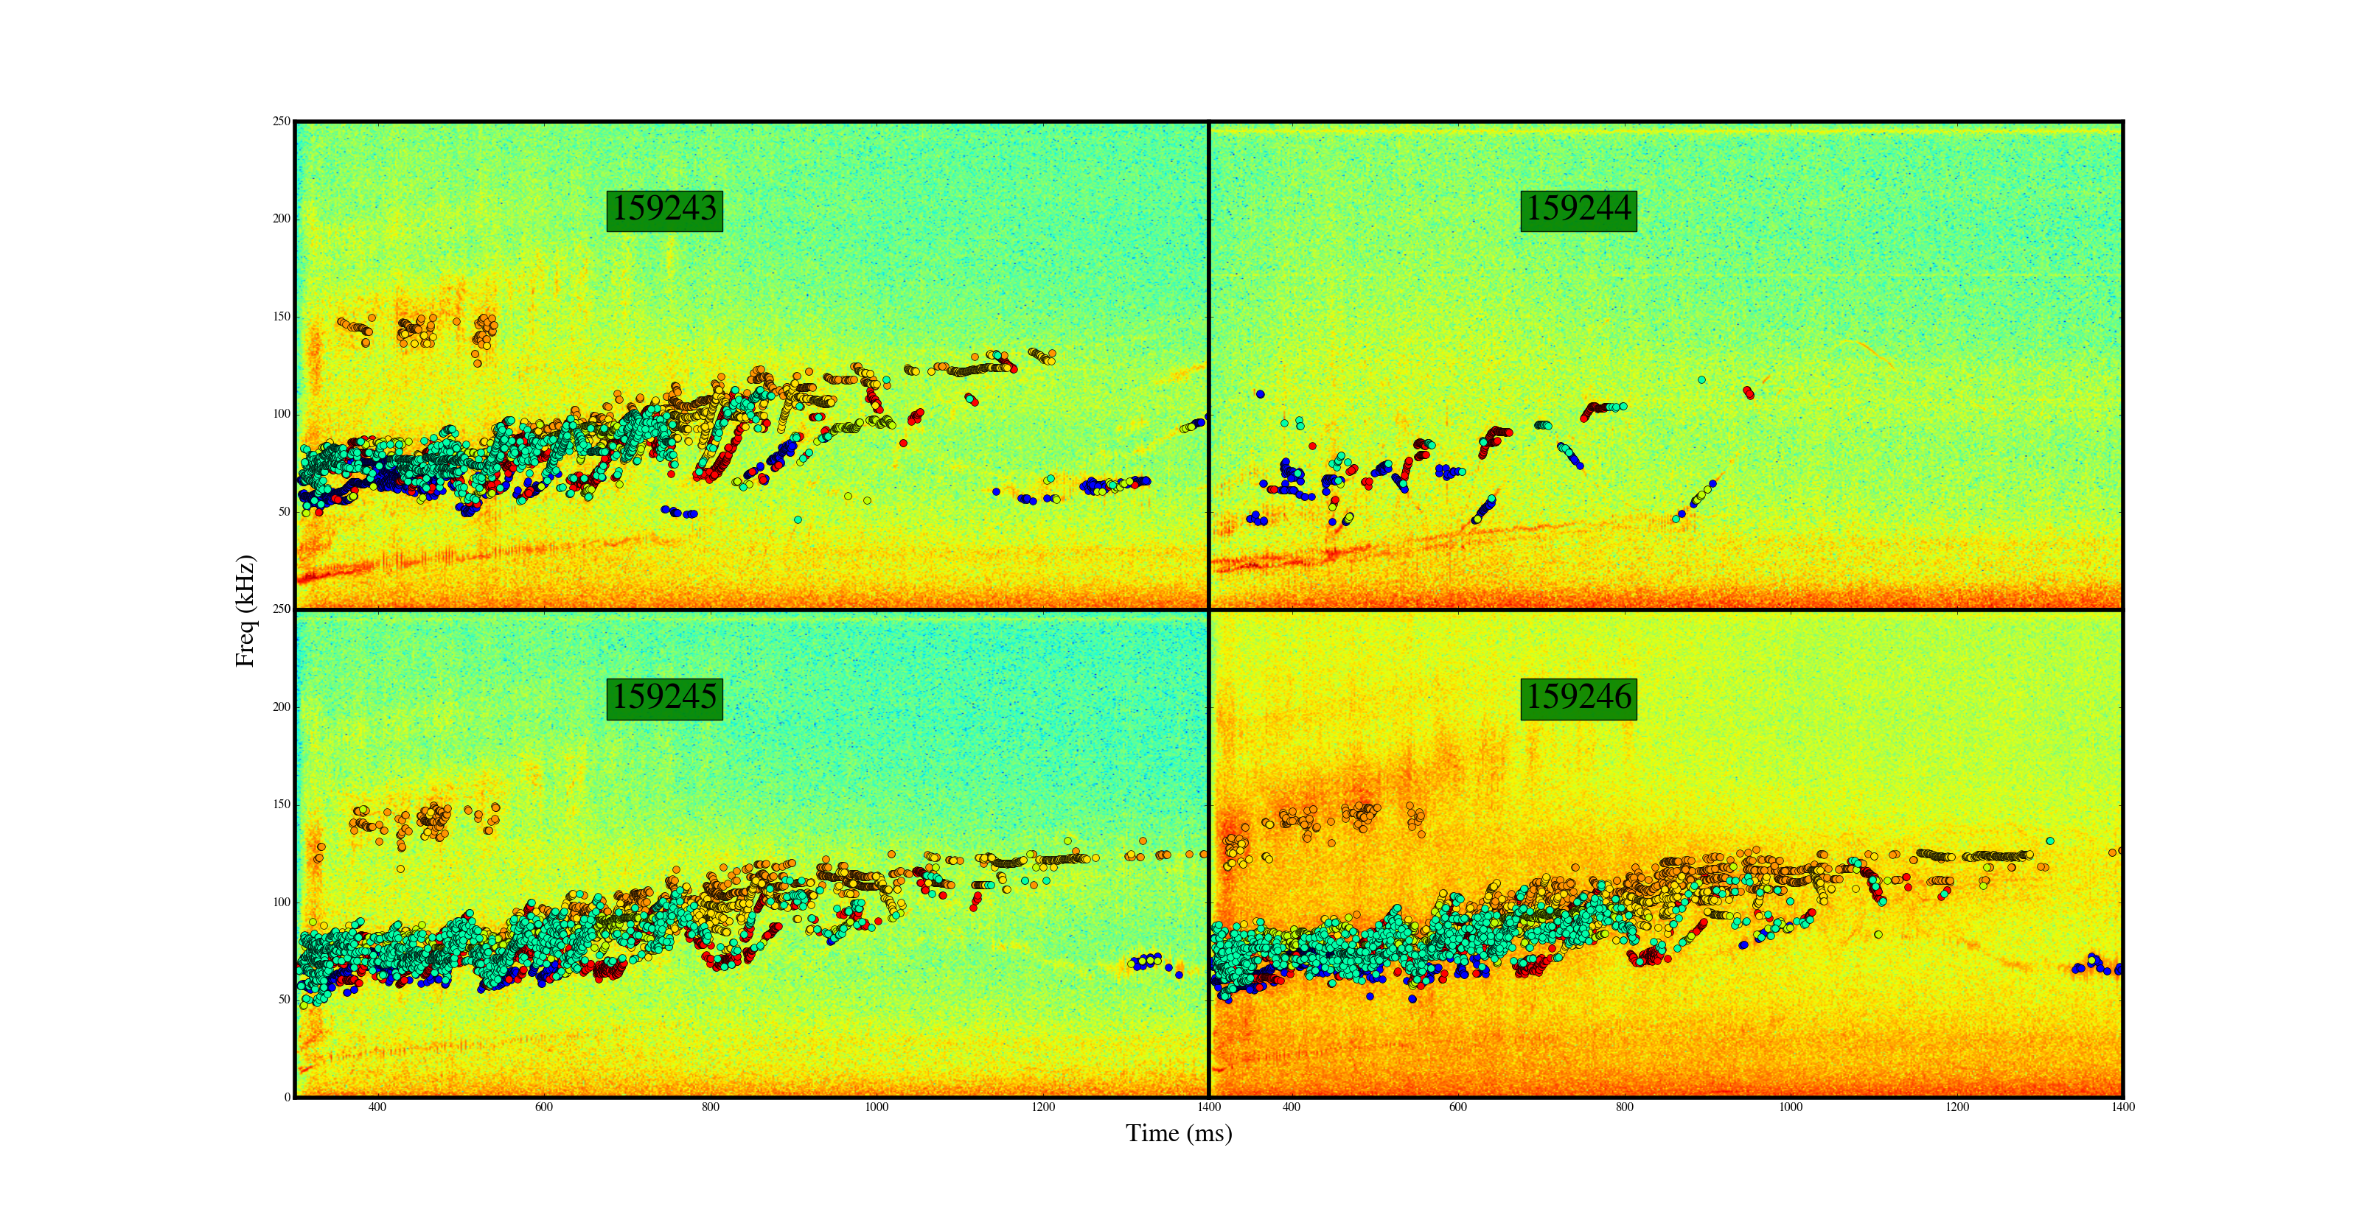
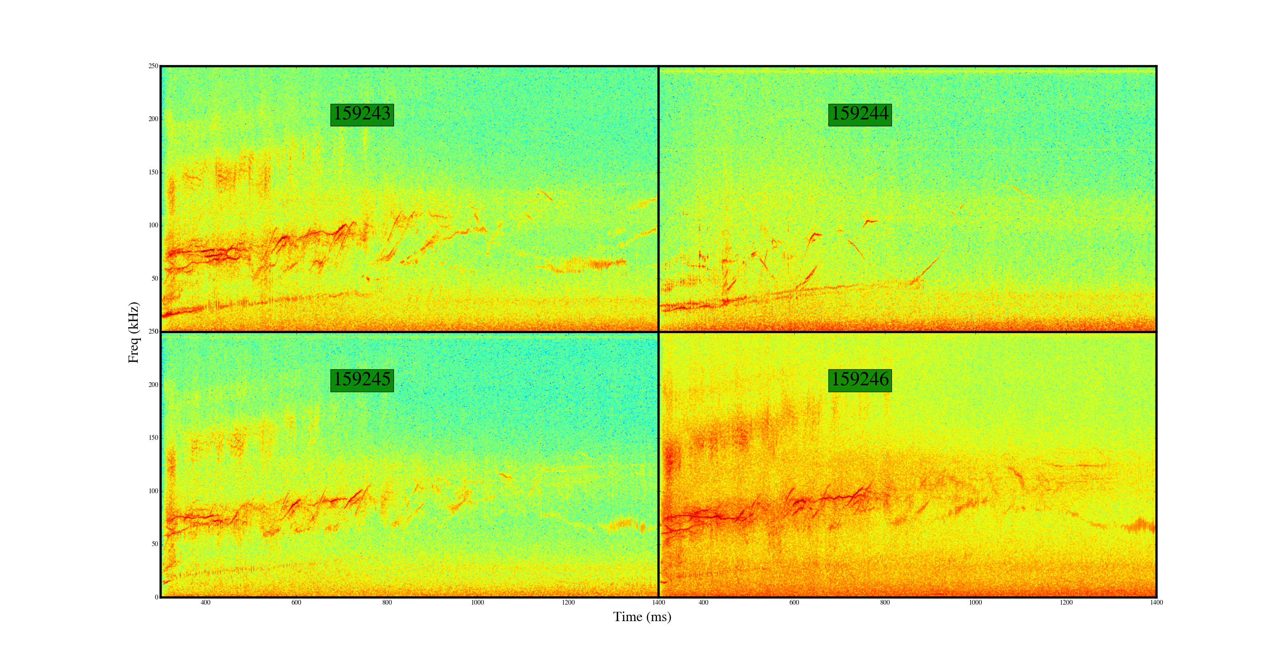
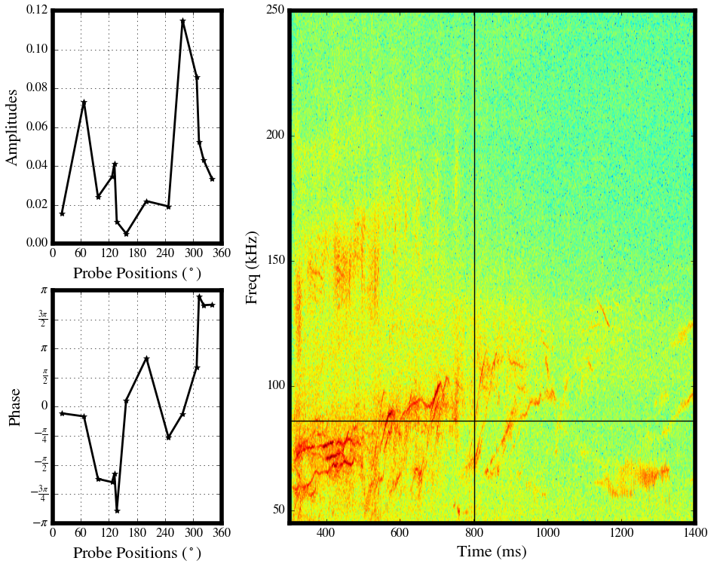
Figure X. Spectrogram of shots 159243 (top left), 159244 (top right), 159245 (bottom left), and 159246 (bottom right) over a time window from 300 ms to 1400 ms. Different clusters are shown in different colors.
Figure X. Raw spectrogram of shots 159243 (top left), 159244 (top right), 159245 (bottom left), and 159246 (bottom right) over a time window from 300 ms to 1400 ms.
159243
t=801.7 ms
f=85.9 kHz
Figure X. Top left: Amplitude vs. probe position. Bottom left: Phase vs. probe position. Right: Raw spectrogram of shot 159243. Output of Analysis.plot_diagnostics routine.

